Slide 1
Seminar 6
Shan Swanlow

Slide 2
Mapping the Skills Matrix to MSc Modules
Area of Competency | Essex Graduate Attribute | Module(s) that taught this skill
Professional | Literacy, communication, language skills | All modules- assignments generally required strong writing and communication skills to express complex ideas within word limits
Professional | Commercial awareness | Software Engineering Project Management, Research Methods and Professional Practice
Professional | Subject understanding, research, critical thinking, time management | Software Engineering Project Management, Research Methods and Professional Practice
Legal and Ethical | Ethical awareness | Research Methods and Professional Practice
Social | Cultural awareness | All modules with group assignments- Secure Software Development, Network and Information Security Management, Software Engineering Project Management

Slide 3
Mapping the Skills Matrix to MSc Modules(cont.)
Area of Competency | Essex Graduate Attribute | Module(s) that taught this skill
Social | Teamwork, leadership and resilience, time management | All modules with group assignments- Secure Software Development, Network and Information Security Management, Software Engineering Project Management
Social | Creativity, entrepreneurial, problem solving, initiative, decision making | Software Engineering Project Management, Research Methods and Professional Practice
Technical | IT and Digital, Numeracy | Secure Software Development, Network and Information Security Management, Software Engineering Project Management, Object Oriented Information Systems

Slide 4
Mapping the Skills Matrix to MSc Modules(cont.)
Area of Competency | Essex Graduate Attribute | Module(s) that taught this skill
Subject application | Global citizen, teamwork, leadership, emotional intelligence | All modules with group assignments- Secure Software Development, Network and Information Security Management, Software Engineering Project Management
Subject application | Decision making, initiative, emotional intelligence, ethical awareness | All modules with group assignments- Secure Software Development, Network and Information Security Management, Software Engineering Project Management. These modules had assignments which required strong knowledge of the fundamentals, and the ability to communicate these fundamentals effectively to get the work done.

Slide 5
Items that should be added to the Skills Matrix
Software Engineering should be added as a subcategory for the Technical competency:
I would argue it fits the Essex Graduate requirement of having IT, Digital and Numeracy skills.
Software Engineering is my career, and I’d argue it’s more than just programming and project management:
The ability to balance competing factors and build solutions that fit those constraints is a skill that’s critical to the field: for example, software engineers often have to balance business needs and deadlines with the technical need to create software that’s easy to maintain and manage.
Knowing how to incrementally deliver work is another key skill that project management methodologies don’t teach. Agile methodologies make it possible to iterate on work, but benefits from that approach are realised only when an engineer is able to break a task down into the smallest unit of work that provides feedback. This is only possible with a very good understanding of the domain and problem at hand.
Lastly, being able to

Slide 6
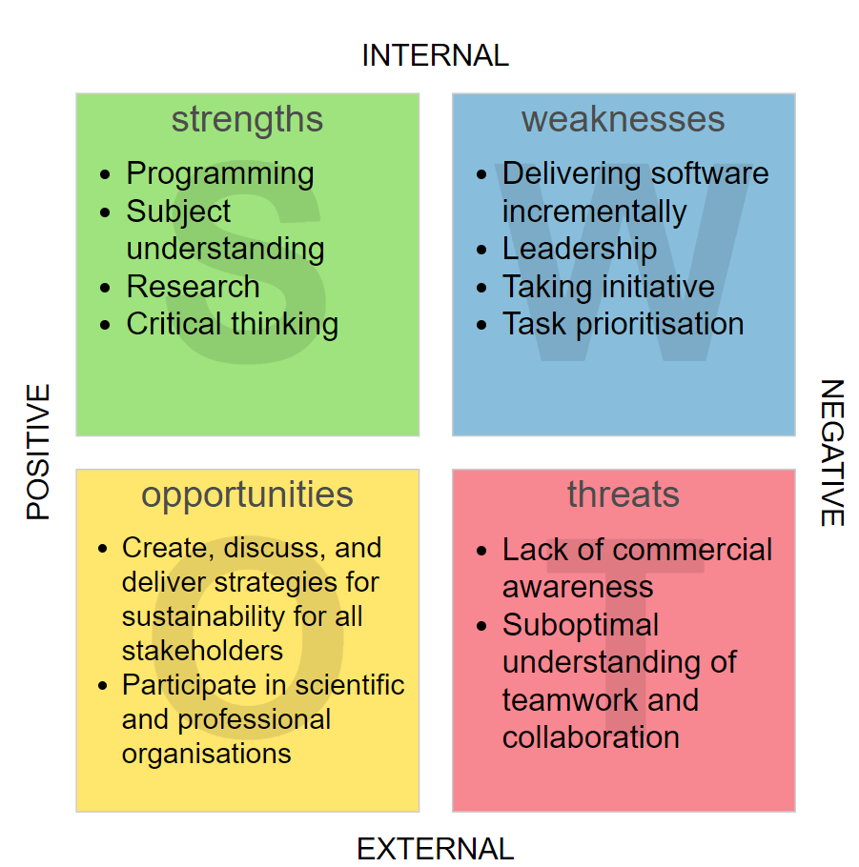
SWOT Analysis
This is based on the skills matrix which I completed, and also what I’ve discovered in my working life.
The SWOT analysis contains what I think should be prioritised for the short to medium term.
The completed skills matrix is viewable on the main page for this module in my ePortfolio.

Slide 7
The Most Influential Module I’ve Completed
The most influential module I studied is the Research Methods and Professional Practice (RMPP) module:
The reason why, is because it helped me learn the skill of evaluating problems from different perspectives to find solutions:
From various content in the module (namely the collaborative discussions), I learned how to evaluate computing problems from a legal, professional, and ethical perspective.
For the research proposal, I had to learn how to evaluate a single problem from various research perspectives. In specific, some academic authors interpret legacy software from a perspective of modernisation, others interpret it as something which introduces risk. I had to learn how to integrate and correlate those perspectives to properly ground my research methodology.
Other modules taught me concrete, technical skills (such as object oriented design and project management methodologies). Those skills are easy to revise with some internet searches, but knowing how to view a problem from multiple perspectives is a skill that cannot be revised with some internet searches- it’s a skill that needs to be learned and practiced consistently. RMPP taught me this skill through the activities and assignments, and I therefore view the module content as unique and highly beneficial.

