Slide 1
Seminar 6 Preparation
AIOps
Group 1

Slide 2
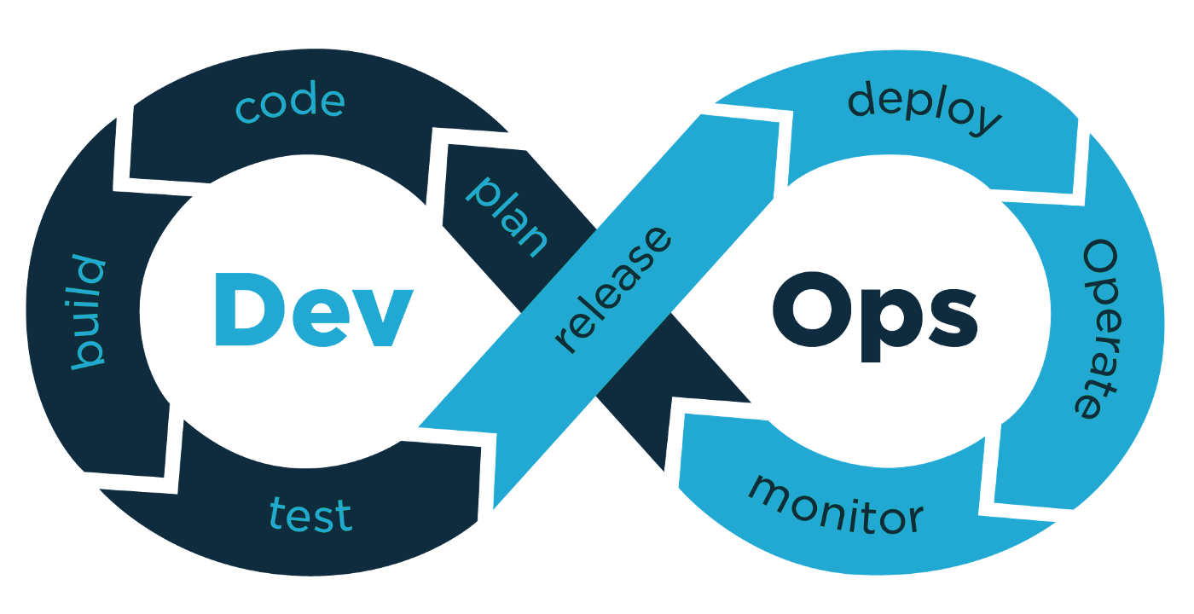
From DevOps to AIOps
DevOps is a cultural philosophy, as well as a set of tools and practices aimed at improving the collaboration between development and operations, and automating continuous delivery of software updates while ensuring its correctness and reliability (Leite et al., 2020).
Organizations embrace DevOps due to the current demand in highly available, rapidly deployed and tested software (Khan et al., 2022).
AIOps is often described as the next logical step in the evolution of DevOps, that would allow for an earlier detection and resolution of service issues, thus helping DevOps teams work even smarter and faster (Shen et al., 2020).
Figure 1: DevOps cycle as per Oteyowo (2018)

Slide 3
What is AIOps ?
AIOps is a shortened form of the phrase "Artificial Intelligence for IT Operations", and refers to the use of artificial intelligence to improve and streamline operational IT workflows (IBM, 2020).
Key benefits of AIOps:
Makes it possible to implement proactive responses to incidents, as opposed to handling them reactively (e.g. AI could detect data integrity issues caused by a bad deployment).
Proactive responses also have the benefit of reducing the mean-time-to-know (MTTK), to a degree that cannot be replicated by non-AI approaches.
AIOps can potentially open the door to creating self-healing infrastructure.
Figure 2: Vision of AIOps from Dang et al. (2019)

Slide 4
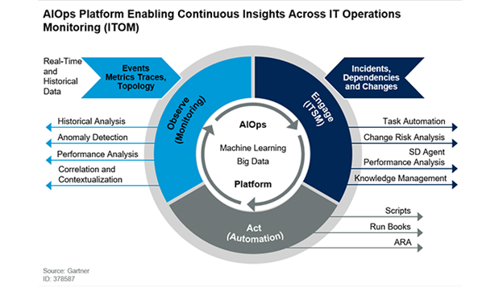
Future Impacts
Automation, integration and data correlation systems to advance
Resolving issues faster
Increased efficiency & customer service
Reducing downtime
Quality improvements
Figure 3: Vision of AIOps from Gartner (nd)

Slide 5
Comparative Importance
Although there are many current useful and future trends, we believe AIOps is the most important as:
IT Ops teams must manage larger and larger more complex data and scenarios generated by modern IT systems (Masood & Hashmi, 2019.). As systems improve in the future this issue is one that must be addressed. AIOps offers a solution to this.
AIOps leverages available technologies to automate some of the data intensive processes.
Allows a form of predictive maintenance to Ops processes to predict issues. Other trends are focused around the handling the outcomes of various issues not foretelling them.
Is considered as the ultimate solution for IT O&M (Shen et al., 2020).

Slide 6
References
Dang, Y., Lin, Q. & Huang, P. (2019) ‘AIOps: Real-World Challenges and Research Innovations’, 2019 IEEE/ACM 41st International Conference on Software Engineering: Companion Proceedings (ICSE-Companion). 4-5.
Gartner (2022) Definition of AIOps (Artificial Intelligence for IT Operations) - Gartner Information Technology Glossary. [online] Available at: <https://www.gartner.com/en/information-technology/glossary/aiops-artificial-intelligence-operations> [Accessed 25 May 2022].
IBM (2020) AIOps. Available from: https://www.ibm.com/cloud/learn/aiops [Accessed 24 May 2022].
Khan, M., Khan, A., Khan, F., Khan, M. & Whangbo, T. (2022) Critical Challenges to Adopt DevOps Culture in Software Organizations: A Systematic Review. IEEE Access 10(1): 14339-14349.
Leite, L., Rocha, C., Kon, F., Milojicic, D. & Meirelles, P. (2020) A Survey of DevOps Concepts and Challenges. ACM Computing Surveys 52(6): 1-35.
Masood, A. & Hashmi, A. (2019) AIOps: predictive analytics & machine learning in operations. In Cognitive Computing Recipes (pp. 359-382). Apress, Berkeley, CA.
Oteyowo, T. (2018) DevOps in a Scaling Environment. Available from:
https://medium.com/tech-tajawal/devops-in-a-scaling-environment-9d5416ecb928 [Accessed 24 May 2022].
Shen, S., Zhang, J., Huang, D. & Xiao, J. (2020) ‘Evolving from Traditional Systems to AIOps: Design, Implementation and Measurements’, 2020 IEEE International Conference on Advances in Electrical Engineering and Computer Applications (AEECA). 25-27 August.

